Slide 1
MAXIV Py-ISPyB & SciCat
ISPyB meeting
Alberto Nardella
Alberto.Nardella@maxiv.lu.se
HAMBURG MAY 19 2025

Slide 2





Overview

Slide 3
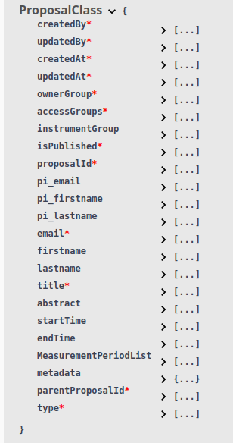
SciCat Proposal
Use the SciCat Proposal object as it is
Use the metadata to store all the ISPyB info needed
Use the same object to store both Proposal and BLSession
Do not store personal information (address, phone, ...)

Slide 4
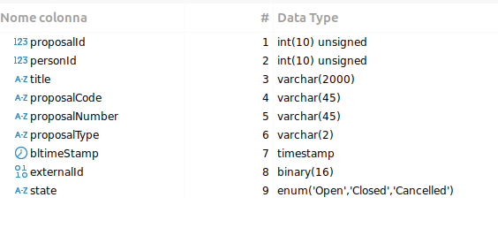
Py-ISPyB Proposal – SciCat Proposal
Type
MX Proposal
Proprietary MX Proposal
Metadata
proposalCode
proposalNumber
proposalType
externalId
state
sessions

Slide 5
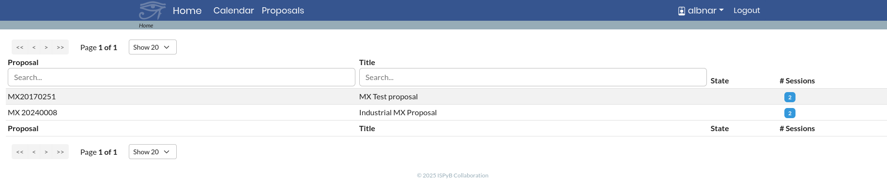
Proposals List

Slide 6
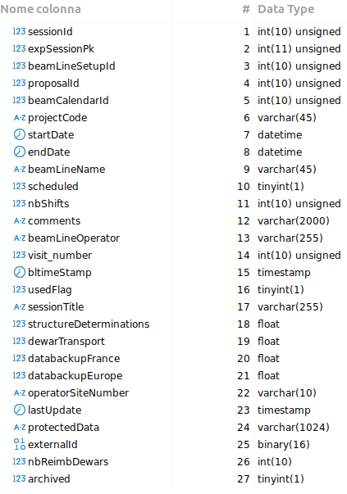
Py-ISPyB BLSession – SciCat Proposal
Type
MX Session
Proprietary MX Session
Metadata
expSessionPk
nbShifts
scheduled
BeamLineSetup
comments
samples
datacollections
energy_scans
xrf_scans

Slide 7
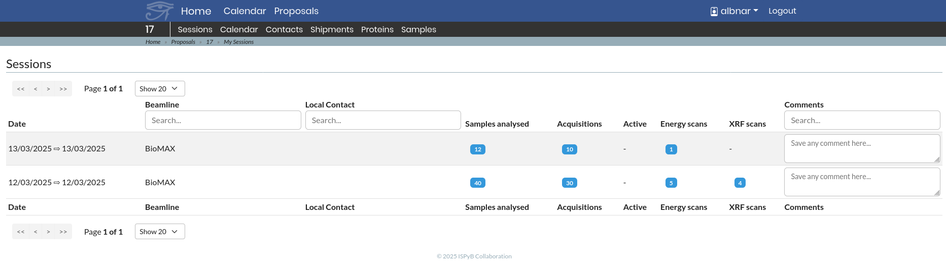
Sessions List

Slide 8




People
Alberto Nardella
Moa Svensson
Carla Takahashi
Massimiliano Novelli
Daphne van Dijken
Marco Avila

Slide 9

Thank you

